Slide 1
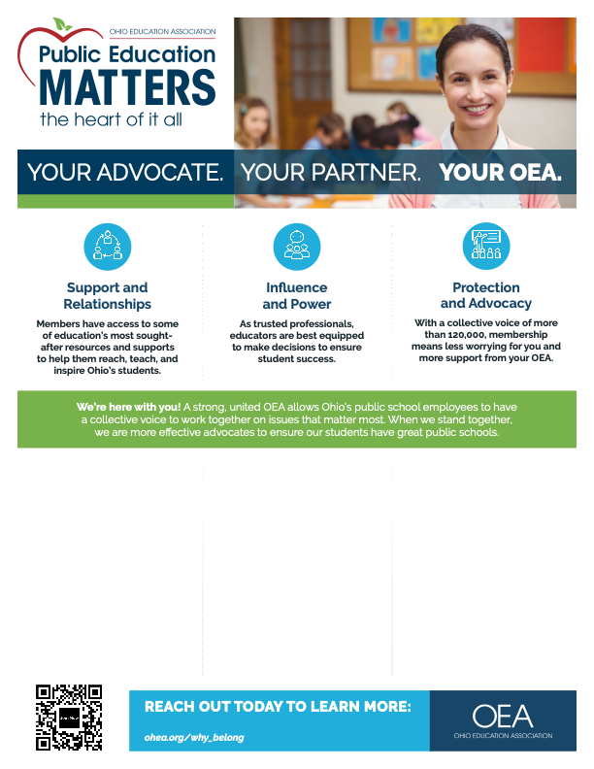
Support and Relationships:
You’re never on your own. OEA is a community of experienced professionals. You will make connections with fellow members at your school, as well as with more than 120,000 members across Ohio and
a network of over 3-million members nationwide.
Through a variety of online and offline tools, you have access to valuable resources on classroom management, lesson planning, job training, and a host of other topics.
Influence and Power:
From your local school board to the state legislature, elected
officials, and people they appoint, set policies that directly affect your work with students. With a collective voice of more than 120,000 members, you can influence those who shape critical policy decisions on issues such as testing, evaluation, licensure, and funding.
It’s our collective mission to ensure educators’ voices are heard and listened to when education policies are made.
Protection and Advocacy:
Membership means you join
forces with fellow educators to make a difference in social justice and equity issues for students.
With representation at the bargaining table, liability insurance, legal representation, and more, your OEA provides advice and professional advocacy on a range of issues you face as an educator. You have a voice
on salary, working and student learning conditions, contract compliance and enforcement, and retirement benefits.
membership@ohea.org | 1-844-632-4636

